Slide 2




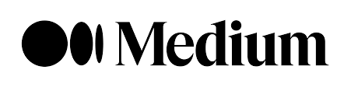
whoami
localhost:~# whoami
crixo
January 2006
Victoria Falls

Slide 3
whoami
Francesco Basco
DEVELOPER @MSC
GitHub: https://github.com/fbasco81
Linkedin: https://www.linkedin.com/in/francesco-basco-6a827387
Email: fbasco81@gmail.com
Facebook: https://www.facebook.com/francesco.basco.9
Garmin: https://connect.garmin.com/modern/profile/FrancescoBasco

Slide 4
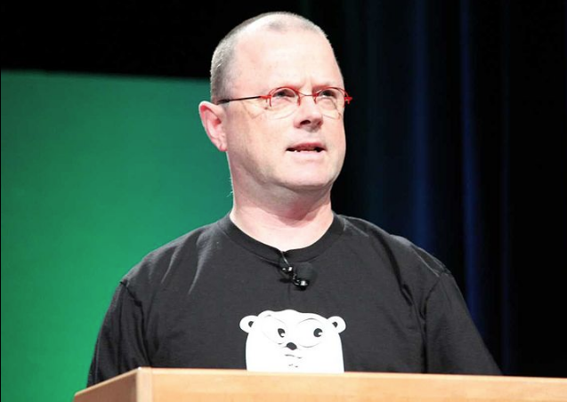
How to communicate
Do not communicate by sharing memory;
instead, share memory by communicating.

Slide 5
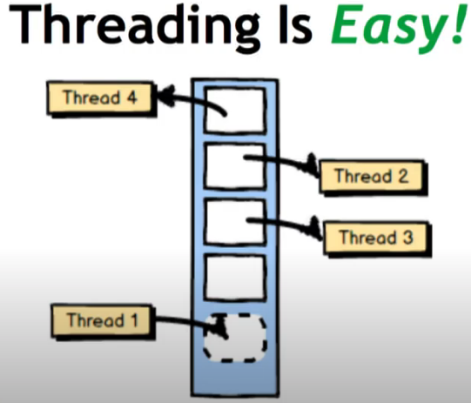
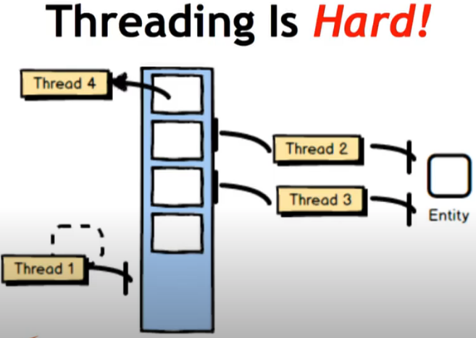
MULTI-THREADING
The Language of Actors - Vaughn Vernon

Slide 6


MULTITHREADING
MULTI-THREADING is HARD
“I know just few programmers capable to write robust and efficent multi-threding code and I’m not one of those”
“Have you written real true multi-threading code? Is it right? you may be one of the few people who can confidently answer that question yes it’s correct because the actual assertion among multi-threading expert is that most multi-threading is wrong”

Slide 7
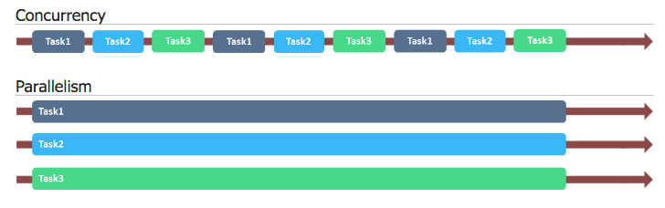
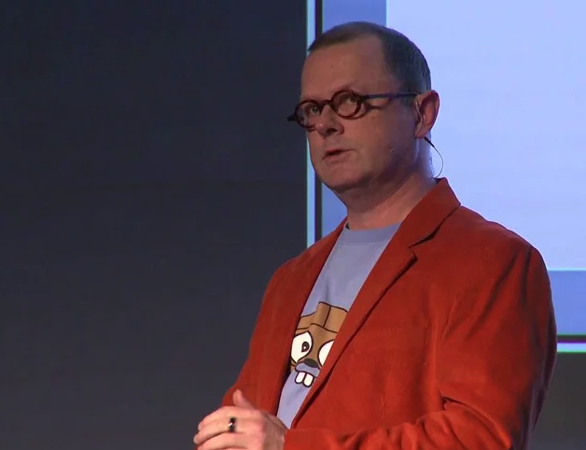
CONCURRENCY vs PARALLELISM
Concurrency vs. Parallelism
Asynchronous vs. Synchronous
Non-blocking vs. Blocking
Deadlock vs. Starvation vs. Live-lock
Race Condition
Non-blocking Guarantees (Progress Conditions)
Akka.net intoduction - Terminology and Concepts
Rob Pike - ‘Concurrency Is Not Parallelism’

Slide 8
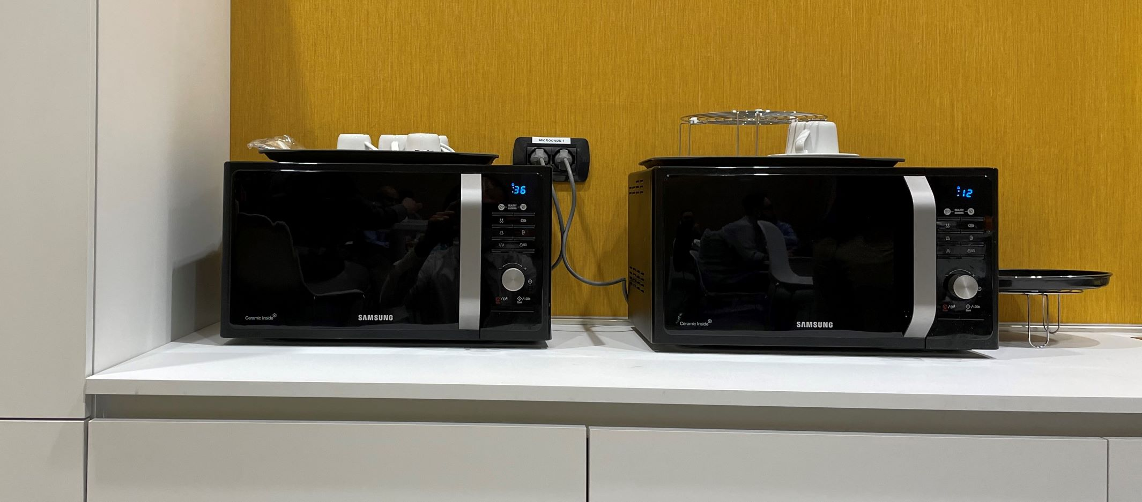
CONCURRENCY vs PARALLELISM
Concurrency is about dealing with a lot of things at once
Parallelism is about doing a lot of things at once.
Rob Pike - ‘Concurrency Is Not Parallelism’

Slide 9
Reactive manifesto
The Reactive Manifesto

Slide 10
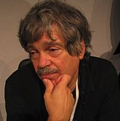
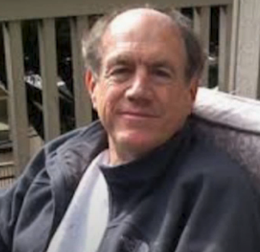


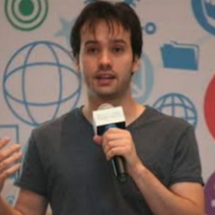
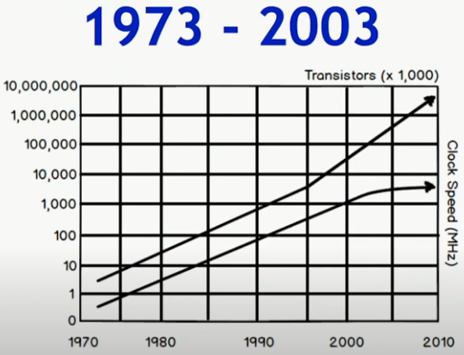
ACTOR-MODEL HISTORY
If you were expecting a sexy or hype topic… sorry but that’s not the case…
Alan Kay
(Smalltalk)
1970
Carl Hewitt
-MIT-
1973
Joe Armstrong
(Erlang)
1986
Jonas Bonér
(Akka)
2009
José Vadim
(Elixir)
2011
Aaron Stannard
(Akka.NET)
2014
Vaughn Vernon - The Language of Actors

Slide 11
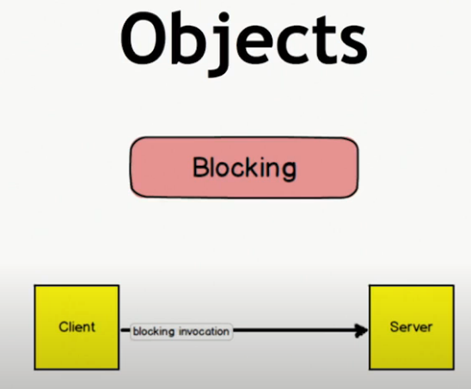
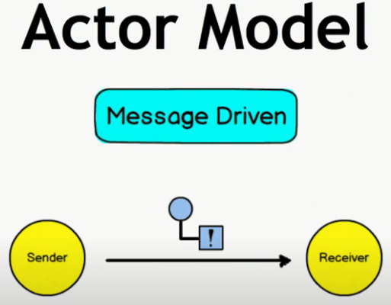
Blocking vs non-blocking

Slide 12
WHAT IS AN ACTOR
An actor is the primitive unit of computation.
It’s the thing that receives a message and do some kind of computation based on it.
The actor model in 10 minutes

Slide 13
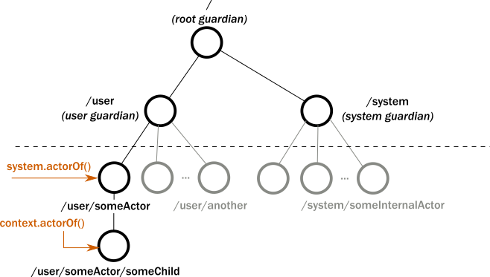
WHAT IS AN ACTOR
One actor is no actor. They come in systems.
The actor model in 10 minutes

Slide 14
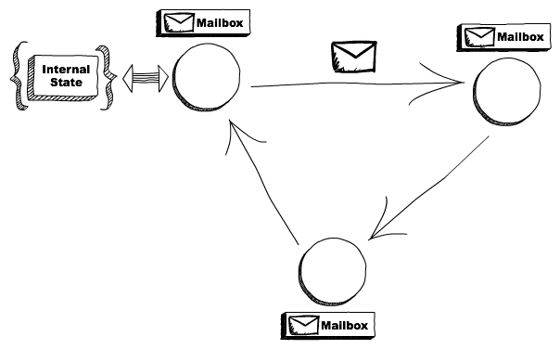
WHAT IS AN ACTOR
Actors are completely isolated from each other and they will never share memory. An actor can maintain a private state that can never be changed directly by another actor.
The actor model in 10 minutes

Slide 15
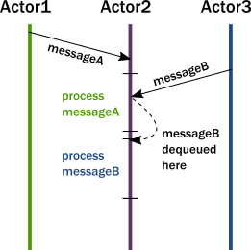
WHAT IS AN ACTOR
Although multiple actors can run at the same time,
an actor will process a given message sequentially.
The actor model in 10 minutes

Slide 16
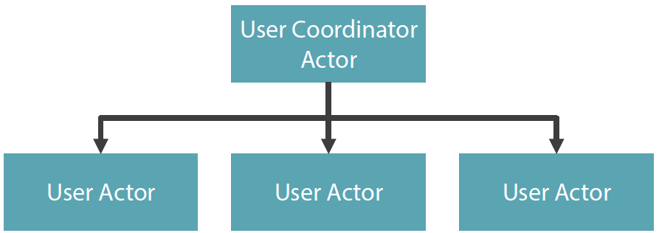
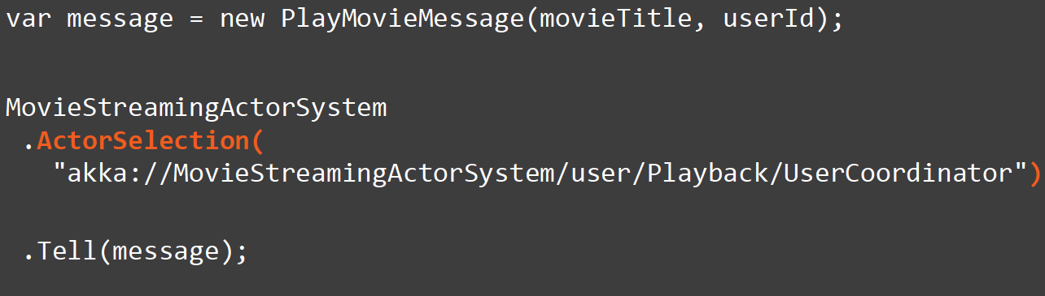
WHAT IS AN ACTOR
When an actor receives a message, it can do one of these 3 things:
Create more actors
Send messages to other actors
Designate what to do with the next message
The actor model in 10 minutes

Slide 17
Communication via direct asynchronous messaging
If the actor A1 is to send message M1 to actor A2, the actor A1 must know the address of actor A2.
If A1 knows A2’s address, it sends M1 directly to A2, but A2 will receive and process M1 on a separate thread. In other words, M1 is delivered asynchronously to A2.
True, there is a layer of indirection between the sending and receiving actor—a mailbox.
Even so, the word direct is used because the programming model provides a worthy abstraction that makes it appear that messages are sent directly from one actor to another.
Vaughn Vernon - Reactive Messaging Patterns With the Actor Model

Slide 18
State machines
Actors support finite state machines.
When an actor transitions to some expected state, it can modify its behaviour in preparation for future messages.
By becoming another kind of message handler, the actor implements a finite state machine.
Vaughn Vernon - Reactive Messaging Patterns With the Actor Model

Slide 19
Lock-free concurrency
Since actors do not share their mutable state,
and because they receive only one message at a time,
actors never need to attempt to lock their state before reacting to a message.
Because locking strategies are both unnecessary and rejected, it frees the CPU cores to focus on pure throughput and allows all reactive components to constantly move forward when they are consuming a thread.
Vaughn Vernon - Reactive Messaging Patterns With the Actor Model

Slide 20
Parallelism
Concurrency and parallelism are different.
Concurrency describes multiple computations occurring simultaneously.
Parallelism is concurrency but applied to achieving a single goal.
Parallelism is achieved by dividing a single complex process into smaller tasks and executing them concurrently.
Parallelism with the Actor model tends to fit well when one higher-level actor can dispatch tasks across several subordinate actors, perhaps even in a complex task processing hierarchy.
Vaughn Vernon - Reactive Messaging Patterns With the Actor Model

Slide 21
Actors come in systems
Carl Hewitt said, “One actor is no actor. Actors come in systems.” That is, one actor gives no parallelism. Actors are very lightweight, so creating many actors within a single system is encouraged.
Any problem can be solved by adding yet another actor.
In addition to these general Actor model characteristics, some others are available as extensions.
Actors Are Cheap
According to our benchmarks on the Akka.NET website, you can fit 2.5 million actors into a single Gigabyte of RAM.
Vaughn Vernon - Reactive Messaging Patterns With the Actor Model

Slide 22
Location transparency
Actor addresses are conveyed to actors using an abstract reference.
If actor A1 obtains such a reference to actor A2, A1 may send message M1 to A2.
The underlying actor system will manage the delivery, whether A2 is on the local actor system or a remote one.
Vaughn Vernon - Reactive Messaging Patterns With the Actor Model

Slide 23
Supervision
Actors form a dependency relationship, where a parent actor supervises child (subordinate) actors.
As a supervisor delegates tasks to subordinate actors, it must respond to the failures of those subordinates.
A valid response may be to resume, restart, or stop the subordinate.
The supervisor may also escalate the failure by electing to fail itself, which would defer failure control to the parent of the supervisor (the supervisor’s supervisor).
Supervision works well in conjunction with parallelism where the supervisor divides tasks among subordinates, which forms a task-solving hierarchy.
Vaughn Vernon - Reactive Messaging Patterns With the Actor Model

Slide 24
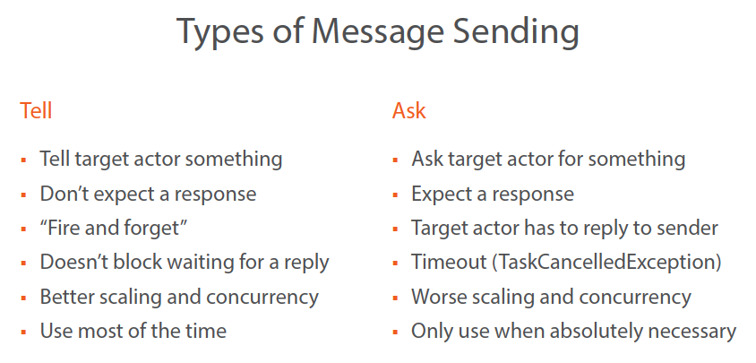
Communication model
(don’t)
unless you are calling from a web app and/or if you cannot channel
Building Concurrent Applications with the Actor Model in Akka.NET

Slide 25
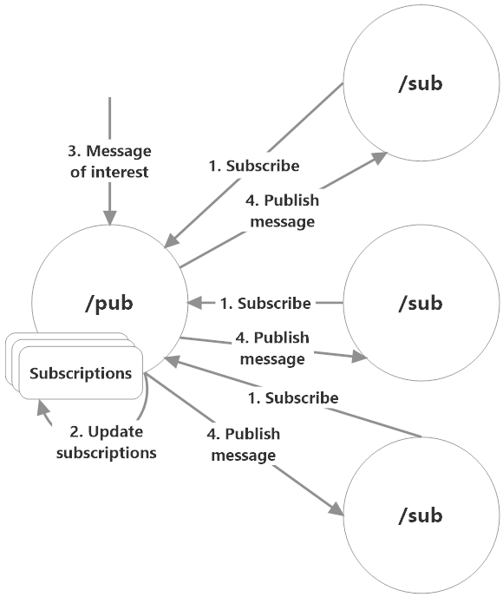
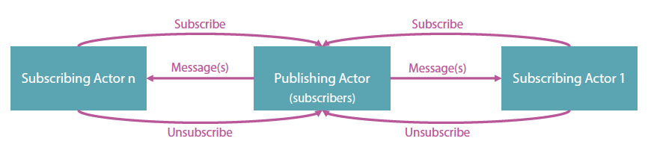
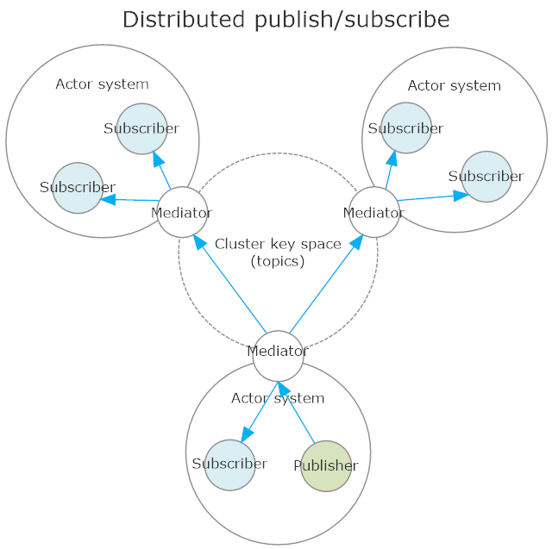
Pub/SUB
Messaging Pattern: Pub-Sub the Actor Model

Slide 26
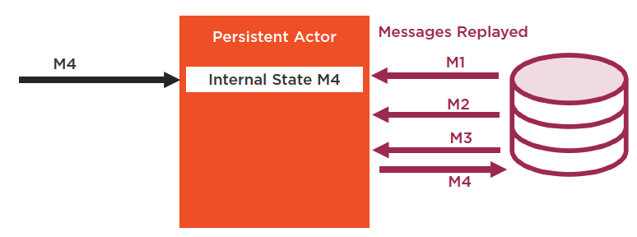
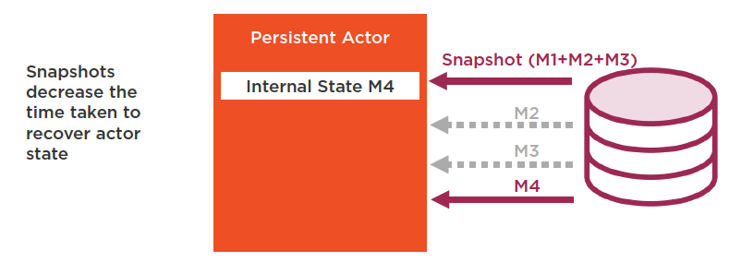
PERSISTENCE
Journals and Snapshots… Event sourcing made easy
Akka.Persistence uses event sourcing to recover and persist internal state from a durable store.
Persistence enables long-running process - Do you know azure “durable function”?
Persistent Actors

Slide 27
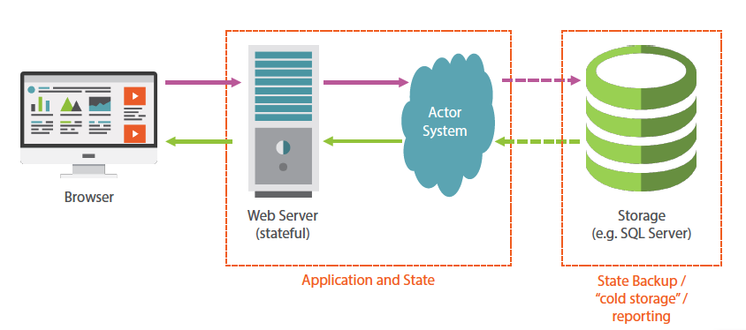
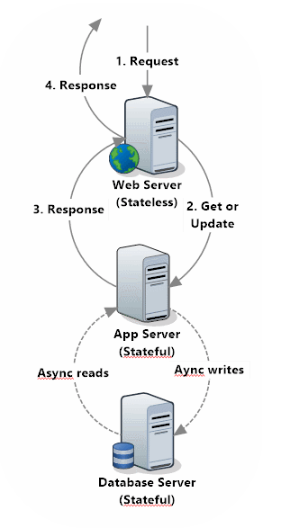
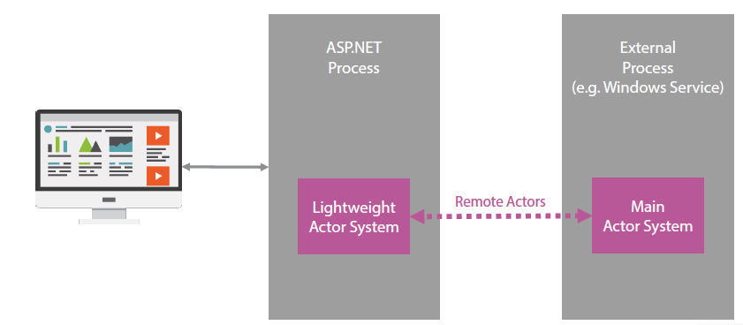
STATEFUL BACKEND
Location-Transparency
8 Fallacies of Distributed Systems:
The network is reliable.
Latency is zero.
Bandwidth is infinite.
The network is secure.
Topology doesn't change.
There is one administrator.
Transport cost is zero.
The network is homogeneous.
Stateful Web Applications

Slide 28
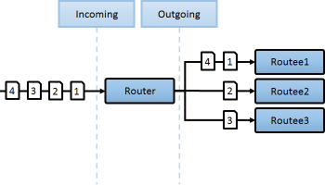
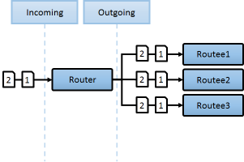

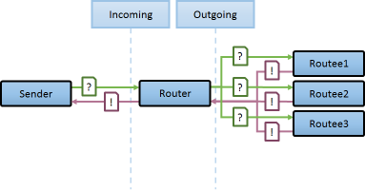
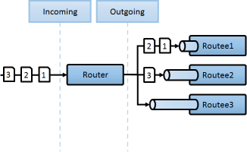
ROUTERS
A router is a special type of actor whose job is to route messages to other actors called routees. Different routers use different strategies to route messages efficiently.
RoundRobin
Broadcast
ConsistentHashing
ScatterGatherFirstCompleted
SmallestMailbox
Routers

Slide 29
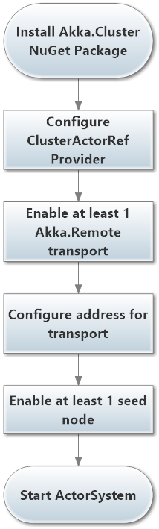
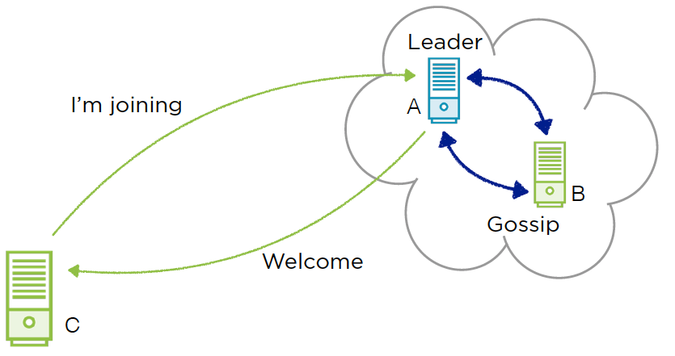
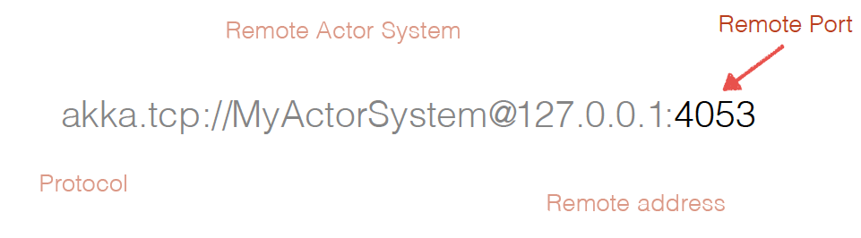
ACTOR CLUSTER
Building Distributed Systems with Akka.NET Clustering

Slide 30
NO OBSERVABILITY NO ACTOR
Don’t do
actor-model / distributed system / messaging in general
unless
you are able to observe
Petabridge.Tracing.ApplicationInsights & akka-monitoring
come to rescue
Why You Should be Paying Attention to OpenTracing

Slide 31
NO TESTS NO PARTY
Debug is not the main/easy option to check your code
Testing is first class citizen in actor-model development
also due to concurrency
How to Unit Test Akka.NET Actors with Akka.TestKit

Slide 32
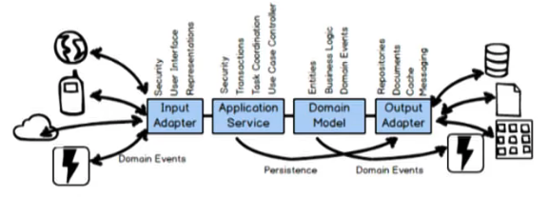
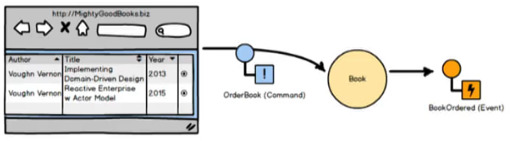
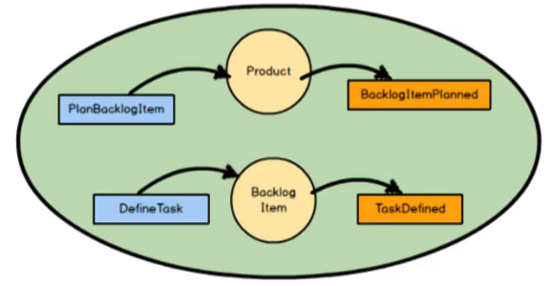
we really need the actor model?
“We are not at Netflix or Google scale…”
A case study for an organization that required 80 servers to run their processes but when they switched to reactive system w/ the actor-model they were able to scale down to a permanent basis to 5 server.
Actor-Model programming style is easy to understand
Complexity Stack
Semplicity Stack
Actor-Model express ubiquitous language
The Language of Actors - Vaughn Vernon

Slide 33
actor model vs MESSAGING
Let’s do a survey…
We already use a Message-Oriented-Middleware, we don’t need an Actor-Model
https://www.surveymonkey.com/r/HZGFRKZ

Slide 34
summary
Wrapping up & recap

Slide 35
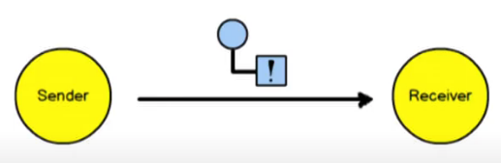
actor model vs MESSAGING
Direct Asynchronous Messaging
the sender of the message must know the address of the actor is sending the message to and the message is delivered asynchronously and process asynchronously
The Language of Actors - Vaughn Vernon

Slide 36
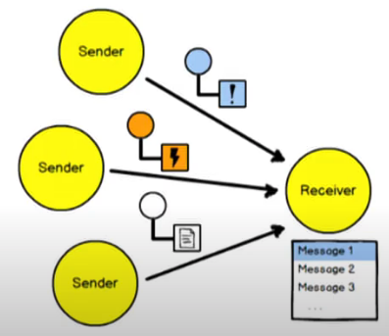
actor model vs MESSAGING
Lock-Free, Share Nothing, Ordering Guarantee
The Language of Actors - Vaughn Vernon

Slide 37
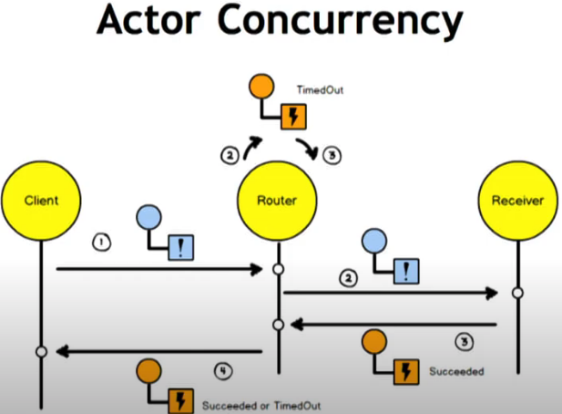

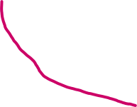
actor model & COncurrency
That’s not a mistake…
That’s concurrency!
The Language of Actors - Vaughn Vernon

Slide 38
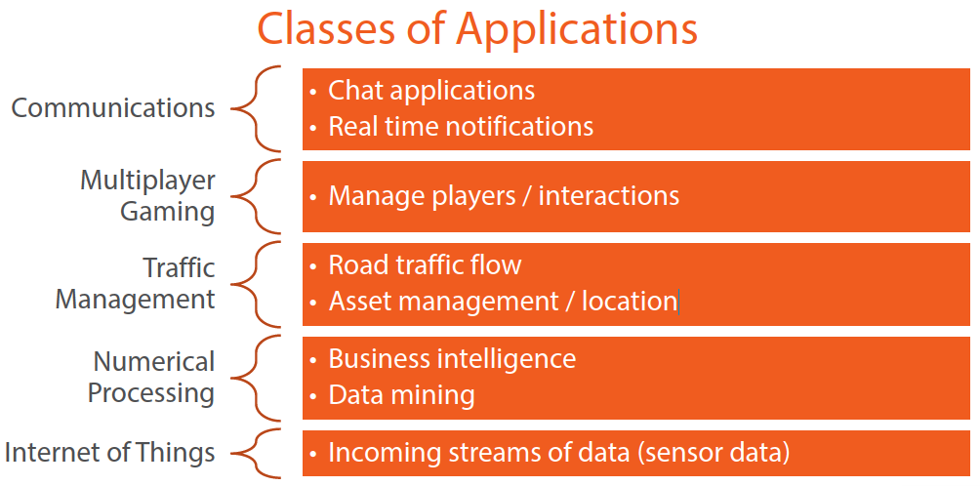
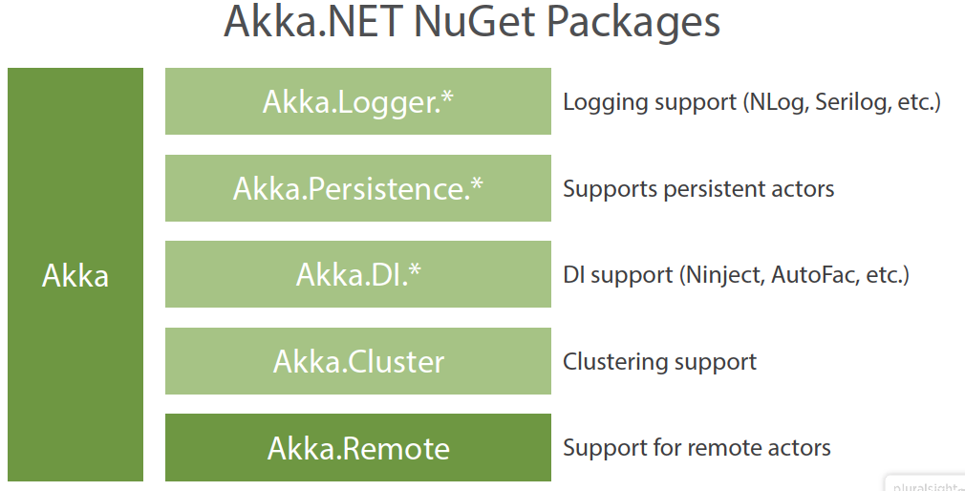
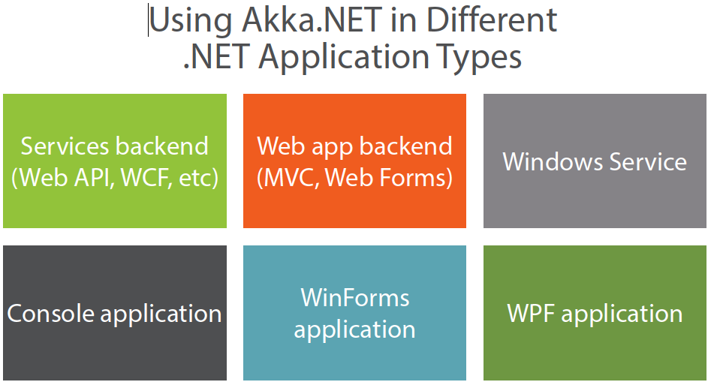
AKKA.NET
Building Concurrent Applications with the Actor Model in Akka.NET

Slide 39
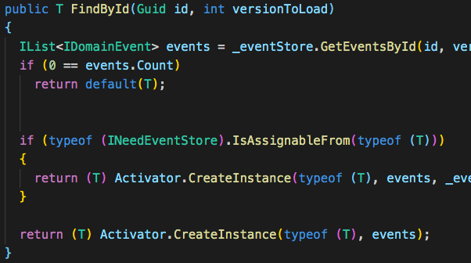
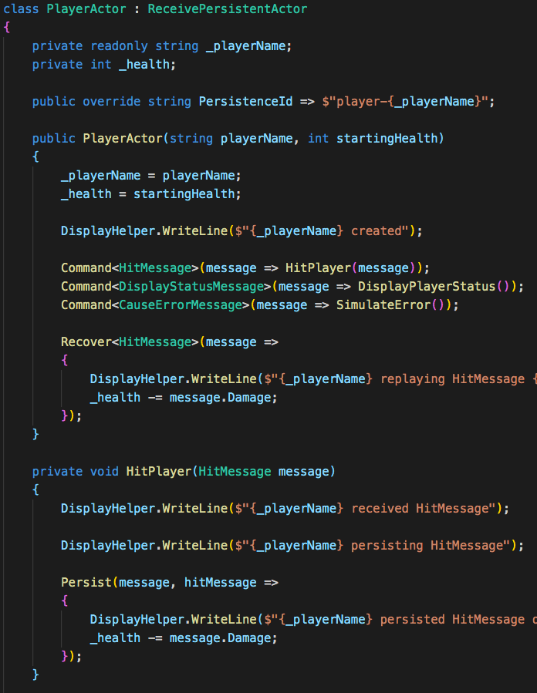
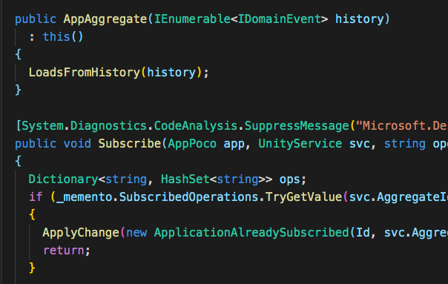
FROM DDD TO ACTORs
Aggregates are Actors

Slide 40
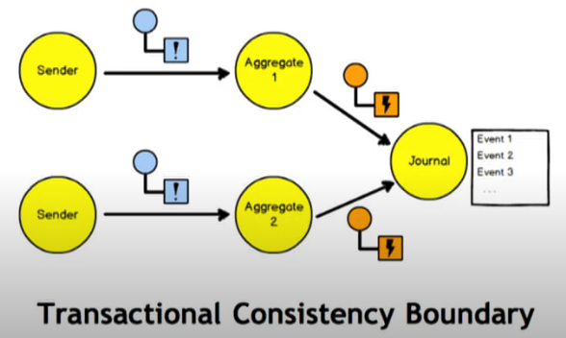
FROM DDD TO ACTORs
Aggregates are Actors

Slide 41
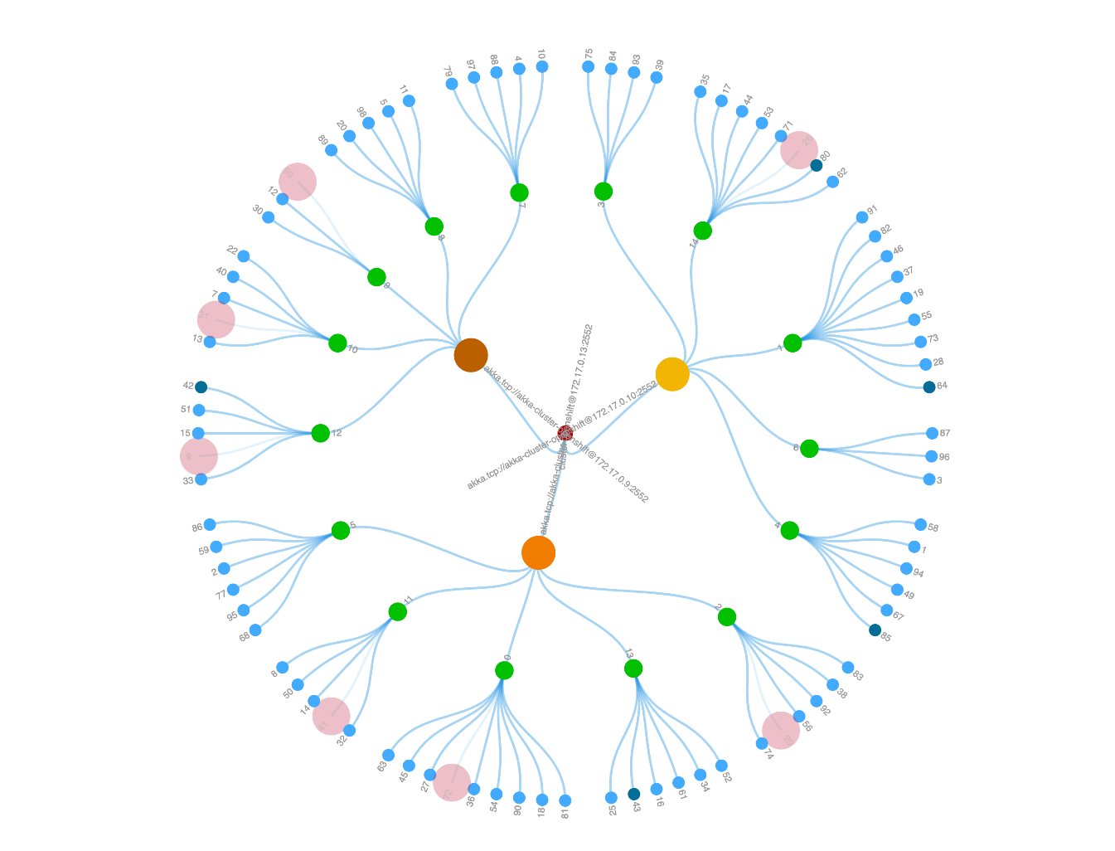


FROM ACTORS TO K8s
Actor-model loves Kubernetes
Cluster Autoscaler
HPA
Deployment
(Akka-cluster)
Actor-system
actor
Akka Java Cluster Kubernetes Example

Slide 42




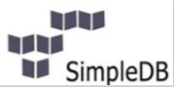
Actor model implementations
Frameworks
Languages
Akka (Scala / Java)
Akka.NET (C# / F#)
Proto.Actor (Golang / C# / Kotlin)
Orleans (C#)
Erlang
Elixir

Slide 43





DEMO
Basket
micro-service
Stateful Reactive
Concurrent SPA
Traffic Control

Slide 44
REferences
Videos
The Language of Actors - Vaughn Vernon
Hewitt, Meijer and Szyperski: The Actor Model (everything you wanted to know...)
Trainings
Petabridge
Pluralisght
Books
Reactive Applications with Akka.NET
Reactive Messaging Patterns with the Actor Model

Slide 45
DEMO
Triathlon simulation
@credit - Traffic Control
.net Core Console Application + Akka.net 1.3
ACTOR CREATION / ACTOR SELECTION
ACTOR TYPES
PROPS
STATE / THREAD SAFETY
MESSAGES
SCHEDULING
EXTEND AN ACTOR SYSTEM
ROUTING
SUPERVISION
REMOTING
LIFECYCLE
CONFIGURATION

Slide 46
DEMO
Triathlon Race
Registration
Bib Number

Slide 47

DEMO
Diagrams
Actor hierarchy & Message flow
Triathlon race

Slide 48
DEMO
A real use case
User migration to azure b2c
~ 160.000 users
1st POC – No Akka.net – No Concurrency - prototype = 8 users / sec ~ 6h
2nd POC – No Akka.net – minimal set of features = 20 users / sec ~ 2h+
3rd POC – Akka.net – all required features added over time = 50 users / sec ~ 53m

Slide 49

DEMO
Diagrams
Actor hierarchy & Message flow
User Migration

